Slide 1














Digital
Portfolio
STUDENT NAME: S. Harish Kumar
REGISTER NO : 24H229
NM NO:239FFC5A9321F6298D54106598A04EEE
DEPARTMENT: BCA
COLLEGE: AM Jain College

Slide 2

Origin of the creative idea
I've designed and developed a comprehensive personal portfolio website that showcases my skills, projects, and professional background as a BCA student and aspiring developer. This responsive single-page application features a clean, modern design with a cohesive color scheme and smooth animations.
The portfolio includes several key sections: an engaging hero section with a clear introduction, a projects display with interactive cards, a detailed skills section with visual progress bars, an education background summary, and a fully functional contact form.

Slide 3
AGENDA
1. )Problem Statement
6.) Features and Functionality
2.) Project Overview
7.) Results and Screenshorts
3. ) End Users
8.) Conclusion
4. )Tools and Technologies
5.) Portfolio Design and Layout
9.) Github Link

Slide 4
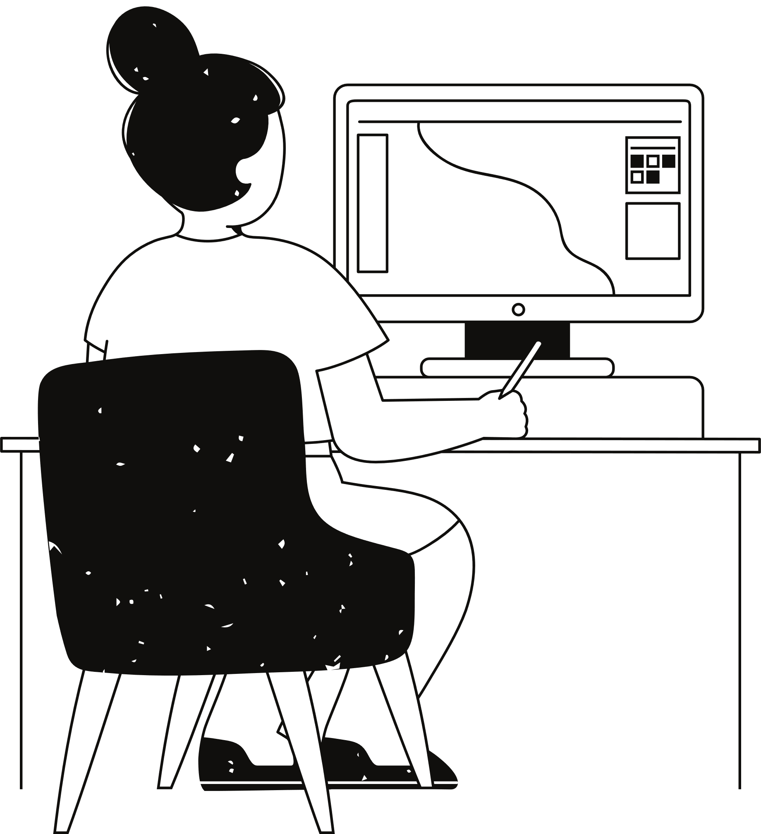
PROBLEM STATEMENT
Lack of Professional Visibility: Many students and junior developers lack a centralized platform to display their technical abilities and completed projects.
Ineffective Self-Presentation: Without a structured format, individuals often fail to communicate their skills and experience in a compelling, organized manner.
Mobile Accessibility Issues: Many portfolio solutions are not fully responsive, creating poor user experiences on mobile devices.
Limited Interactivity: Static portfolios fail to engage visitors and demonstrate technical capability through interactive elements.

Slide 5
PROJECT OVERVIEW
01
02
03
04
A responsive portfolio website showcasing my skills, projects, and qualifications as a BCA student and aspiring developer. It serves as a professional online presence to attract potential employers and clients.
Responsive design with mobile-friendly hamburger menu
Interactive project showcase with hover effects
Skills visualization with animated progress bars
Contact form with proper input validation
Built with pure HTML5, CSS3, and vanilla JavaScript
CSS Grid and Flexbox for responsive layouts
Custom CSS animations and transitions
Mobile-first responsive design approach
Clean, modern aesthetic with cohesive color scheme
Card-based layout for project presentation
Gradient accents and subtle shadow effects
Consistent typography and spacing throughout

Slide 6
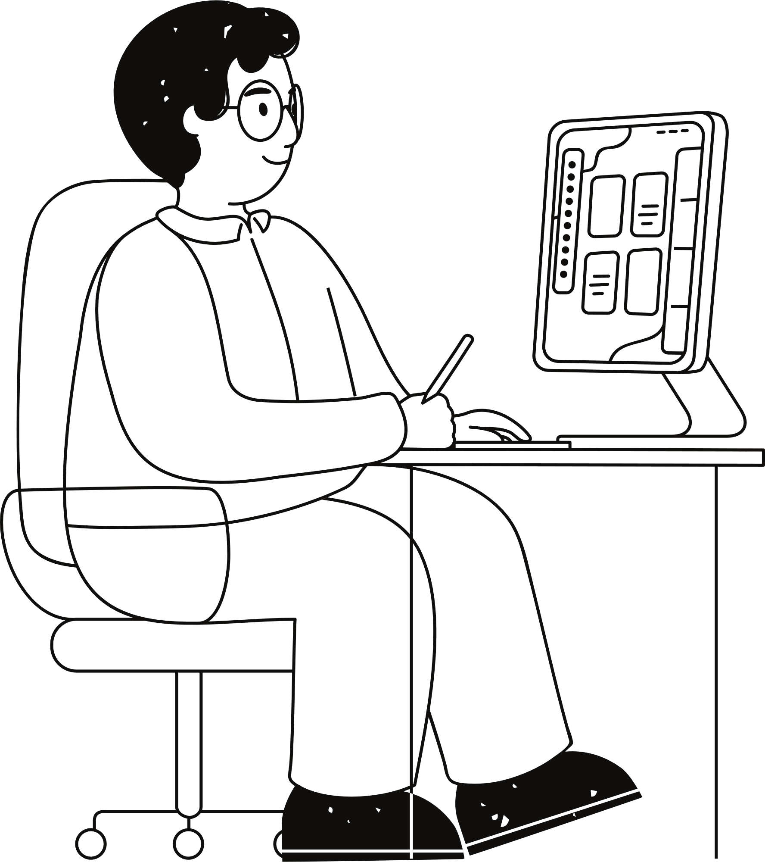
Who are the end users ?
This portfolio website serves multiple end user groups including potential employers and recruiters seeking technical talent, academic institutions evaluating applicants, clients looking for development services, professional networks interested in collaboration, educational contacts tracking progress, and personal connections wanting to understand my professional capabilities. The design accommodates all these audiences through clear organization, responsive functionality, and comprehensive project showcasing.

Slide 7

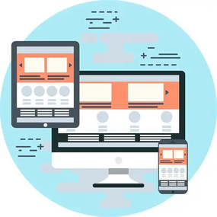


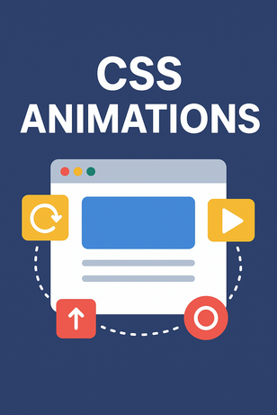

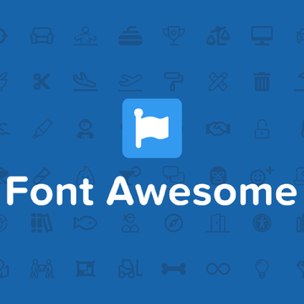
The project utilizes modern HTML5 semantic elements such as <header>, <section>, <nav>, and <footer> to create a well-organized, accessible document structure. This approach enhances both SEO optimization and screen reader compatibility while providing clear content hierarchy.
The project was developed with a mobile-first approach using CSS media queries to ensure optimal viewing experiences across all device sizes. The design adapts fluidly from mobile devices to desktop computers, with particular attention to touch targets and readable text on smaller screens.
The implementation makes comprehensive use of CSS3 capabilities including Flexbox and CSS Grid for creating responsive, complex layouts. Custom properties were employed for consistent theming, , gradient backgrounds, and shadow effects contribute to the visual appeal.
Tools and technique
Custom CSS transitions and keyframe animations were implemented to enhance user engagement and provide visual feedback. These include hover effects on project cards, smooth gradient transitions in the background, and subtle micro-interactions throughout the interface.
Exploring creativity
All interactive elements were built using pure JavaScript without external libraries or frameworks. This includes the responsive hamburger menu functionality, smooth scrolling navigation between sections, scroll-to-top button with appearance logic, and form validation for the contact section.
The project incorporates Font Awesome icons for improved visual communication and user interface elements. These icons provide intuitive visual cues for navigation items, contact information, and social media links, contributing to a more polished and professional appearance.

Slide 8
Portfolio Design and Layout
Header- Sticky header with logo, navigation menu, and resume download button
Hero - Introduction with name, professional title, brief bio, and call-to-action buttons
Projects - Showcase of portfolio projects with images, descriptions, and links
Skills - Visual display of technical skills with progress bars and categories
Education - Academic background, coursework, and relevant learning experiences
Contact - Contact information and functional contact form

Slide 9
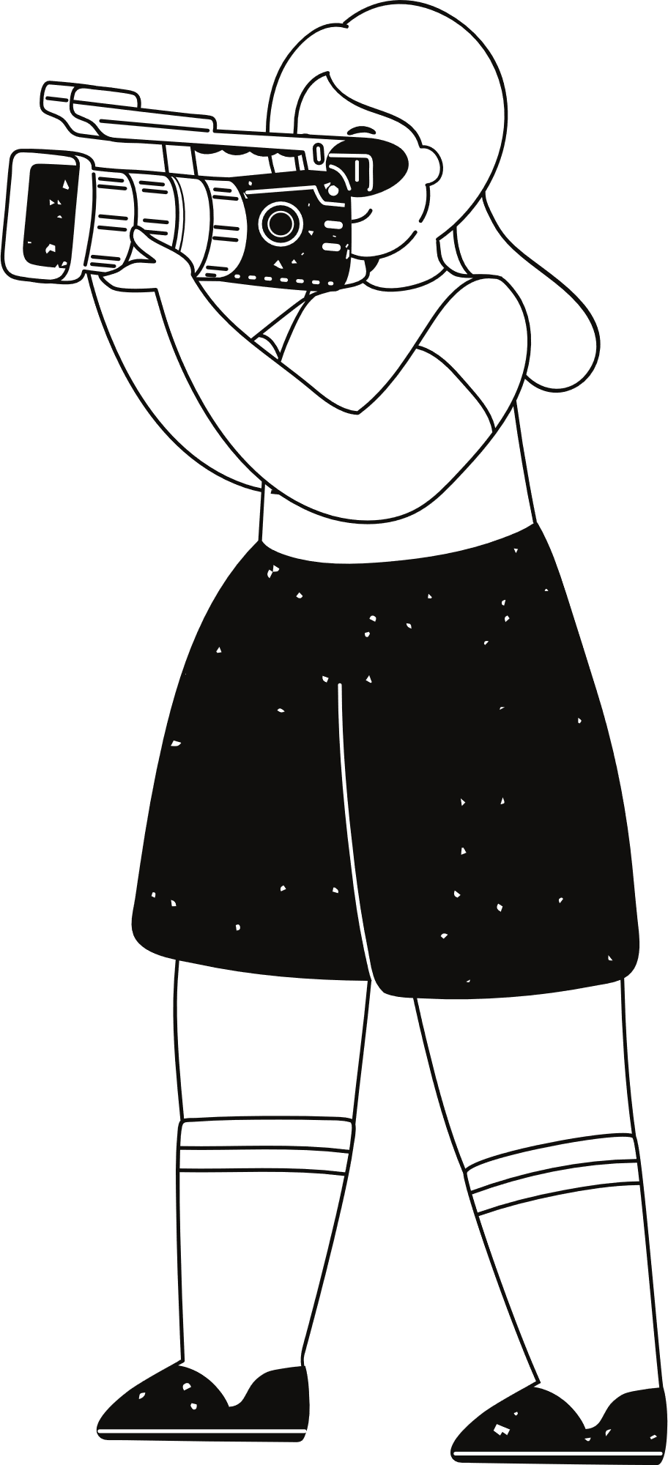
Features and Functionality
User Interface Features
Interactive Elements
The portfolio features a fully responsive layout that automatically adapts to desktop, tablet, and mobile screens, ensuring optimal viewing experience across all devices.
The interface includes hover effects providing visual feedback, form validation for the contact section, and a convenient scroll-to-top button that appears after scrolling down.
Technical Implementation
Modern Navigation
Built with semantic HTML structure and vanilla JavaScript for functionality, the portfolio uses CSS variables for consistent theming without external framework dependencies.
A sticky navigation bar remains accessible while scrolling, complemented by smooth scrolling between sections and a mobile-friendly hamburger menu for smaller screens.

Slide 10
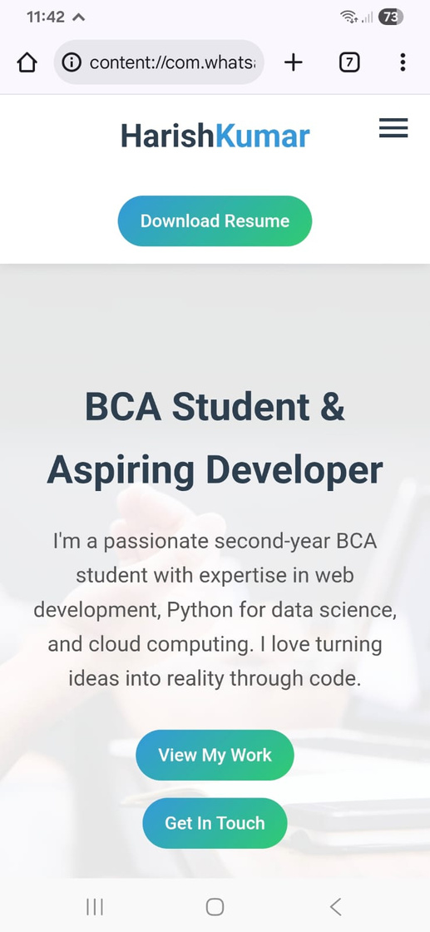
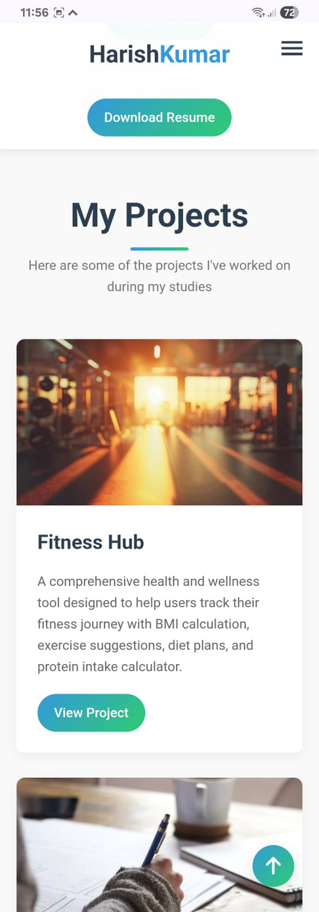
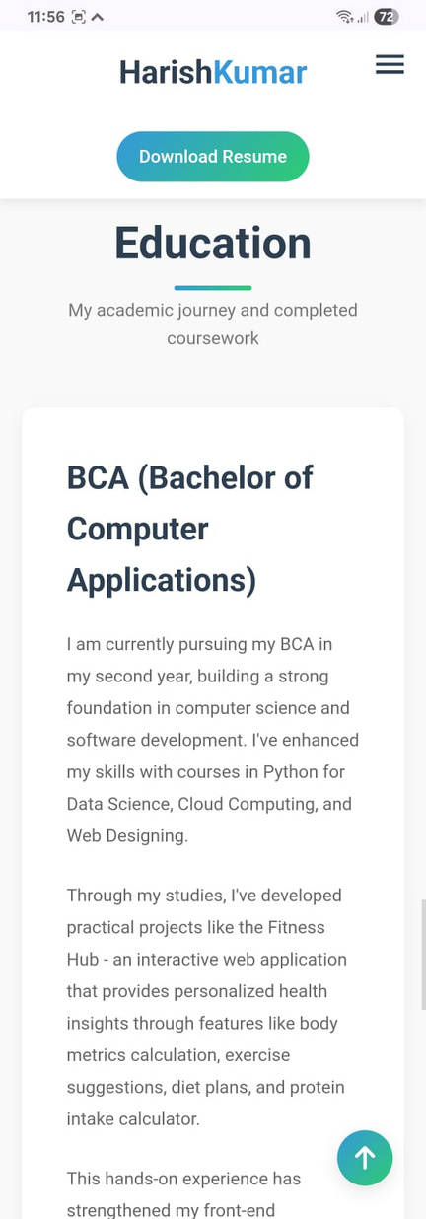
Results and Screenshots

Slide 11
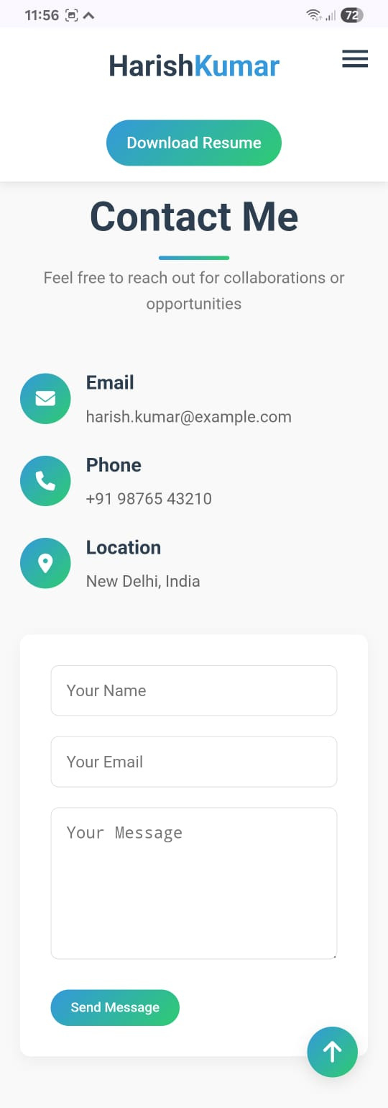

Slide 12
Conclusion
Through the development of this portfolio website, I have successfully created a dynamic and professional platform that effectively showcases my skills, projects, and educational background as a BCA student and aspiring developer. This project demonstrates my proficiency in front-end technologies, responsive design principles, and user experience optimization, while the clean code structure and interactive elements highlight my technical capabilities and attention to detail. The portfolio not only serves as a comprehensive display of my current abilities but also reflects my potential for growth and my commitment to creating impactful digital solutions in my future career.

Slide 13
Thank you very much!

